Slide 1
Learning Words

Slide 2
Game plan
Lecture: Solving the mapping problem
  What does it mean to learn a word? What is in a lexicon? How do learn children what belongs together?
    Mutual Exclusivity, Whole-object bias, ...
  Theories
    Gawagai-Problem, Vocabulary Spurt, Continuity Hypothesis

Slide 3
Journal (5 minutes)
What did you think of Jake and Nate’s performance? Did you have any other insights into our experiment?
Notes:
Nate and Jake's performance was to capture a crucial shift in the way that children learn language, called fast-mapping.

Slide 4
Early Words are different
Object/Noun bias
  Contextually influenced (reading vs. playing w cars)
  Less complex (verbs are relationally complex)
Gesture Dependent
  Pointing, reaching
Over Extensions
  No one-to-one mapping of meaning to form (ball)
Notes:
Noun bias may be a function of what’s tested. When reading a book, more likely to produce nouns, than when playing w a truck.
Ball for everything round e.g. apple (ah-ball, ba-ball).

Slide 5
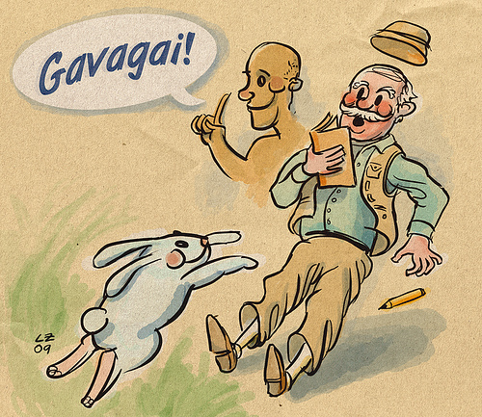
Why is word learning difficult?
Quine: Indeterminacy of translation
Notes:
Look, a rabbit. Look, food. Let’s go hunting. There will be a storm tonight.

Slide 6
Early Word Learning
Problem:
  An infinite array of possibilities for a child to consider in learning what a word means
  By adulthood, we have learned approx. 60,000 words
Nevertheless:
  Children learn words with just one exposure to a word and what it means
  Even a 10-month-old knows around 35 words!

Slide 7
Limiting potential hypotheses
If children had to consider so many hypotheses when learning words, they would never suceed at the task.
  So how do they learn words?
If children only consider a small number of hypotheses, then word learning might be easier.
    What kind of things constrain the meanings that children consider?

Slide 8

Constraints
Probabilistic biases that provide first guesses as to the solution of a problem – default assumptions
(Gould & Marler, 1984)
Notes:
Bees need to know what flowers contain a certain nectar. Default is “purple”. There are certainly other possible colors, but it’s a good first guess.

Slide 9
Constraints
Logical constraints on reasoning – either innate or learned - that constrain what a word may refer to
Social constraints limit possible meanings
Syntactic frames limit what a new word potentially refers to
Notes:
Joint attention typically look at objects and events; physical cues such as pointing and eye gaze; shared knowledge about language conventions (pointing typically identifies a “thing”)

Slide 10
Whole Object Assumption
Novel names refer to whole objects rather than to parts of objects
  Is the bias driven merely by the shape of the object or the object itself?
    Children do not treat novel labels as referring to non-solid substances even though they are molded into common shapes (Soja et al. 1991)
Notes:
One task that experimenters have used to probe these issues is a novel word learning task (Landau et al., 1988; Soja et al., 1991; Soja, 1992; Smith et al., 1996; Gathercole & Min, 1997; Imai & Gentner, 1997; Jones & Smith, 1999). In these tasks, the child is presented with a novel exemplar and is told its name, e.g. `this is the mel'. The child is then shown test items that match the exemplar on one perceptual property or another and is asked which of these test items can be called by the same name as the exemplar. Numerous studies using this task have demonstrated that when the exemplar is a solid object, 2- and 3-year-olds robustly generalize the novel name to new instances by shape (Landau et al., 1988; Soja et al., 1991; Imai & Gentner, 1997). However, when the exemplar is formed from non-solid stuff, children typically do not generalize the name by shape. Instead they are more likely to generalize the name to new instances that are made from the same material as the exemplar (Dickinson, 1988; Soja et al., 1991; Soja, 1992; Imai & Gentner, 1997). … Quine (1960) hypothesized that the ontological categories of object and substance emerged as a consequence of language learning, the product of contingencies between language and perception. Soja et al. (1991) offered an alternative hypothesis: that children approach the task of language learning with a pre-existing set of ontological categories and more specically with the knowledge that solid whole objects are organized into kinds by their bounded shapes but that non-solid substances are organized into kinds by their material. (Samuelson & Smith, 1999, p. 2)

Slide 11
Mutual Exclusivity
Every object has only one label
  The new word must refer to Object A or B. It is not A since A is X, therefore, it is B
Two predictions:
  Second labels for objects are harder to learn (Liitschwager & Markmann, 1991)
  When given a novel label in the presence of only one object, children look for another object (Markmann & Wasow, 1993)
Notes:
Children prefer only one label for an object. Mutual exclusivity may help them override whole-object assumption when working with one object with a known label.

Slide 12
Brainstorming for final project

Slide 13
Quiz 3 Review
Statistical Learning
Perceptual Magnet
Formants
Perceptual Categorization
Universal Listener
Neural Commitment Hypothesis
Universal Theory/Selection Theory vs. Perceptual Learning vs. Attunement
Domain Generality
Innate Bias for Speech
Naming Insight

Slide 14
Kooijman et al. 2005: EEG and word segementation
Familiarization “Python, python, python, python”
Test: (4) Familiarized “You should always be careful with a python”
(4) Unfamiliarized “The court jester sometimes makes weird jokes.”
Notes:
Taking a step back on word learning …. At 10 mos, what happens in the infant’s brain as a particular word in the speech stream is heard?
28 Dutch 10 mos olds
Familiarized on target words. target words and their component syllables were distinctive and unlikely to be familiar to the infants
Note that sentences were in Dutch, so the position of the noun was not sentence final for one and medial for the other as in the English example above!
Image: http://www.nature.com/news/the-big-baby-experiment-1.18701

Slide 15
Results: Familiarization
Notes:
Positivity clearly diminishes with familiarization. Thus, the Familiarization phase has produced a clear Familiarity effect -- reduced
positivity with increasing familiarity—Starting very early on in the word (at about 160 ms) and spanning most of the word’s duration.

Slide 16
Results: Test
Notes:
The method we have developed has allowed us to see a
cortical effect of word Familiarity in the 10-month-old’s
brain. The effect takes the form of a reduced positivity with
increasing familiarity. In the Familiarization phase, we
observed that the effect started very early on in the word
(at about 160 ms). The two-syllable words were on average
710 ms long, so the Familiarity response started while the
infants were hearing the early parts of the words. In the Test
phase, we observed further evidence of a recognition
response to the words that had been presented in the
Familiarization phase. Here, the 10-month-olds heard every
one of these words in a position internal to the sentences in
running speech, and in no case was there a pause at the
boundary of the critical word. Yet these infants, for whom
the utterances were presumably meaningless, initiated the
recognition response to the familiar words within half a
second. Initiation of the response was about 180 ms later in
the Test phase, in which the words occurred in the
sentences, than in the Familiarization phase, in which the
words occurred in isolation.
In our experiment, we may assume that no semantic
representation was activated in the 10-month-olds’ memory
when a newly familiar word form was re-encountered. T

Slide 17
Social Constraints
Social interactions determine reference
  Eye-movements towards an object when labeling
  Knowledge of intentions of the speaker
  Speaker’s knowledge
Infants use an adult’s eye-gaze to determine reference of an object?

Slide 18
Social Constraints
Baldwin (1991)
  2 objects: 1 visible, 1 hidden in a bucket
  Infant plays with the object while hearing a label
    When experimenter looks at the toy
    When experimenter looks into the bucket
    Can you find the Toma?
  72% of children point to visible object when experimenter looks at the toy
  34% point to the visible object when experimenter looks in the bucket

Slide 19
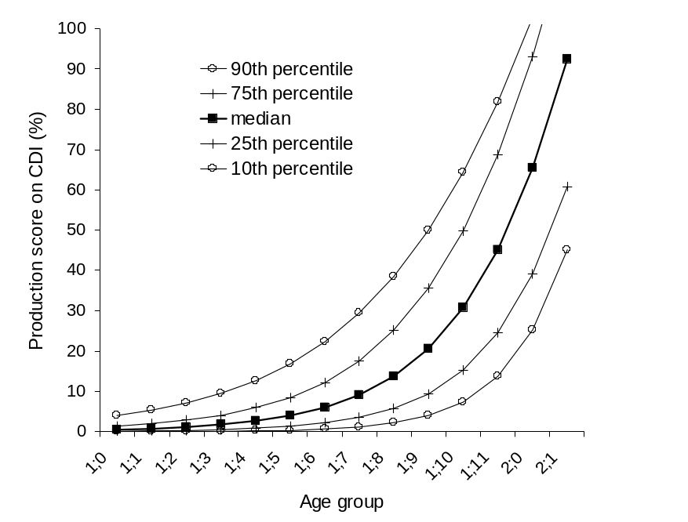
The Vocabulary Spurt
Starts around 12 months
Early development is slow
Vocabulary spurt
  accelerated growth around 21 months
5-10 words per day? (really at most 5-10 per week).
Review Bloom & Markson p. 68
Productive Vocabulary
Hamilton, Plunkett & Schafer (2000)

Slide 20
The Vocabulary Spurt
Productive Vocabulary
Discontinuity in performance = Discontinuity in process?
A new stage in children’s development or a refinement of early processing?
Hamilton, Plunkett & Schafer (2000)

Slide 21
Words that Change the World: The Naming Insight
http://www.radiolab.org/story/91728-words-that-change-the-world/
Notes:
Why do children gradually improve at word learning? One possibility is the awareness that things can be named.
Story of Susan Schaller who teaches a young deaf man and taught him to sign.
Start at 5:50 minutes run till 10:00

Slide 22
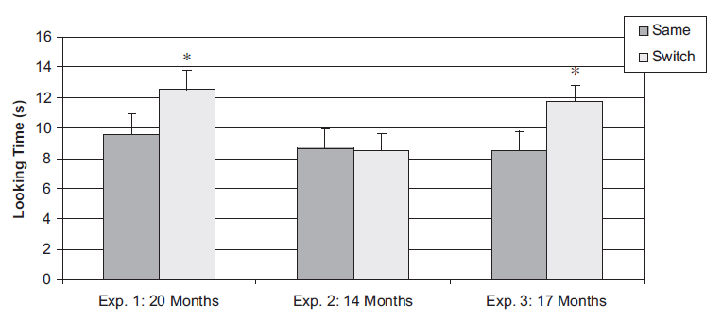
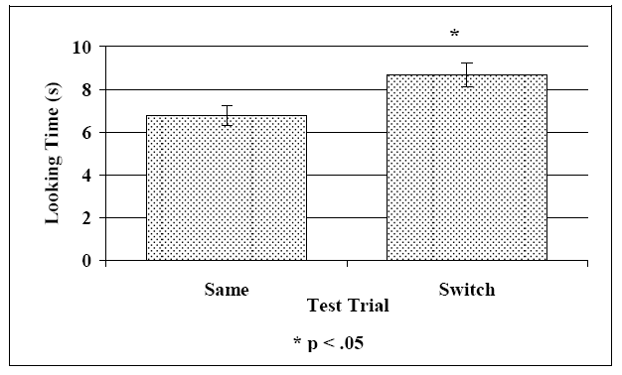
The Naming Insight McShane (1979)
Word-Object associations make 14-month-olds unable to discriminate between two similar sounding words
17-month-old have no problems with the same task
14-month-olds are successful if aware that the labels are the object’s names
Do 17-month-olds know that labels are names of objects?
Fennell et al., 2002; Fennell & Waxman, 2010
Notes:
Why do children gradually improve at word learning? One possibility is the awareness that things can be named.
Remember the switch task, where infants are exposed to a novel word-object pairing (bin/din; Stager & Werker, 1997). Remember that 14-mos-olds failed to indentify the mismatch. But they do detect the difference between “lif” and “neem”. And they can do a standard speech discrimination task between “b” and “d” (the checker board without the images). They can also do it with known words (ball vs. doll; Swingley, 2005). Are the demands of word learning so hard? Problem: Nothing in the task/design of the study clues babies into the fact that the novel word refers to the object (referencing is absent). Words presented in isolation, with no social or grammatical context. Words rarely occur in isolation! (Namy & Waxman, 2000 – Look! Blick! – infants don’t establish word-object mapping). This experiment: Experiment 1: “Look. It’s the bin/din/neem. There’s the bin/din/neem. Do you see theh bin/din/neem? … (7 different phrases!). Now they can do it. Experiment 2: Still in isolation, but preceded by labeled familiar objects (Car, Kitty,…) SOCIAL, LINGUISTIC, and PRAGMATIC information help to establish referential connections.

Slide 23
Markson & Bloom
Is word learning the result of domain-specific or domain-general abilities?
acquisition of novel words and facts may share important components
  establish a mapping to a designated individual
  retain the mapping over time
Notes:
which aspects of language acquisition are specific to language, and which are shared more generally with other cognitive tasks
Cf. Waxman & Booth 2001

Slide 24
M&B conclusions
Fast-mapping is not specific to word learning
Evidence that word learning is the product of domain-general abilities
BUT could word-learning still have distinct differences as well?
What if children's extension of proper names differs from their extension of facts?
Notes:
What do you think of claim 1?
What do you think of claim 2?
Fast-mapping as only one component of word learning
Children systematically extend the novel word to include all and only members of the same object category
as the designated individual; they extended the novel fact randomly (see Behrend,
Kleinknecht, Sco¨eld, & Wilcox, 2000). This sharp contrast between the systematic
extension of the word, and the random extension of the fact suggests that there may
indeed be principles guiding the acquisition of words that are not invoked in acquiring
facts.

Slide 25
Learning Words: When things go wrong

Slide 26
Game plan
Lecture: neural correlates of ASD and word learning
  How does atypical language learning deviate from typical language learning?
    Neural correlates, it‘s not all or nothing ...

Slide 27
Quiz Review

Slide 28
Why is word learning difficult?
Quine: Indeterminacy of translation
Notes:
Look, a rabbit. Look, food. Let’s go hunting. There will be a storm tonight.

Slide 29
Autism Spectrum Disorder & Language Acquisition
Wide variation in severity
Characteristic social deficits including language deficits
Relationship with ERP measures of word processing?

Slide 30
Coffey-Corina et al. 2008
24 toddlers with ASD (18-31 mos)
20 TD toddlers as control
STIMULI (customized based on parental report)
  Known words (10)
  Unknown words (10)
  Backwards words (10)
Each word presented 6 x
Diagnostic Measures given before testing & 1 yr later
Notes:
Diagnostic measures including the Autism Diagnostic
Observation Schedule [7] and the Mullen Scales of Early
Learning [8] were collected from toddlers with ASD prior
to ERP testing and one year after testing.

Slide 31
Notes:
Fig. 1. ERP waveforms for TD toddlers (left) and toddlers with ASD (right). Typically Developing (TD) toddlers exhibit a localized response with
significant differences between K and UK at left temporal electrode site (T3). Toddlers with ASD exhibit a diffuse response to
K and UK – differences are significant across all electrode sites in the 500-700 ms measurement window.

Slide 32
Zooming In …
typical
ASD

Slide 33
High vs. Low Functioning ASD toddlers
Notes:
ERP waveforms for HF toddlers with ASD (left) and LF toddlers with ASD (right). HF toddlers exhibit a localized
response with significant differences between K and UK at the parietal electrode site in the left hemisphere (P3). LF toddlers
exhibit a diffuse response to K and UK with significant differences in multiple time windows and electrode sites. In addition,
the difference between K and UK is significant when collapsed across all electrode sites in the 500-700 ms measurement
window.

Slide 34
Do ERPs predict verbal IQ?
Notes:
Fig.4 Predictive correlations between mean amplitude for Known
words at the parietal electrode sites (P3/4) in the 200-500
ms measurement window and verbal IQ. A more negative
response predicted higher verbal IQ one year after ERP data
was collected. The correlation was significant at left
parietal, P3 (r = -.521, p = .013, left) and approached
significance at right parietal, P4 (r = -.421, p = .051, right).

Slide 35
Summary
TD controls exhibited a focused response ASD toddlers exhibited a diffuse response with longer latency.
HF toddlers with ASD exhibit an ERP response very similar to TD controls
LF toddlers’ response significantly different from HF and TD toddlers: broad distribution confined to RT Hemi
Patterns of ERPs effectively predicted behavioral scores 1 year later.

Slide 36
Discussion
Group results can underestimate individual children’s skills.
Findings support Neuroimaging results
Potential relationship between linguistic and social deficits characteristic of autism
Notes:
Broca’s area is larger in the left than right for
typical subjects and has been implicated in phonological
and semantic processing of language stimuli. Herbert et al.
[9] reported reversed asymmetry in frontal language related
cortex (Broca’s area) in school aged boys with
ASD when compared to TD controls.
Harris and colleagues (2006) [11] reported more activation
in Wernicke’s area and reduced activation in Broca’s area
in an fMRI study of adults with ASD during word
meaning tasks.

Slide 37
Class Thoughts?
What were ERP results able to add to fMRI results?
Does anyone see any potential clinical applications?
Notes:
ERPs show more about processing. Potential differences in structure reflect processing differences.

